Slide 1
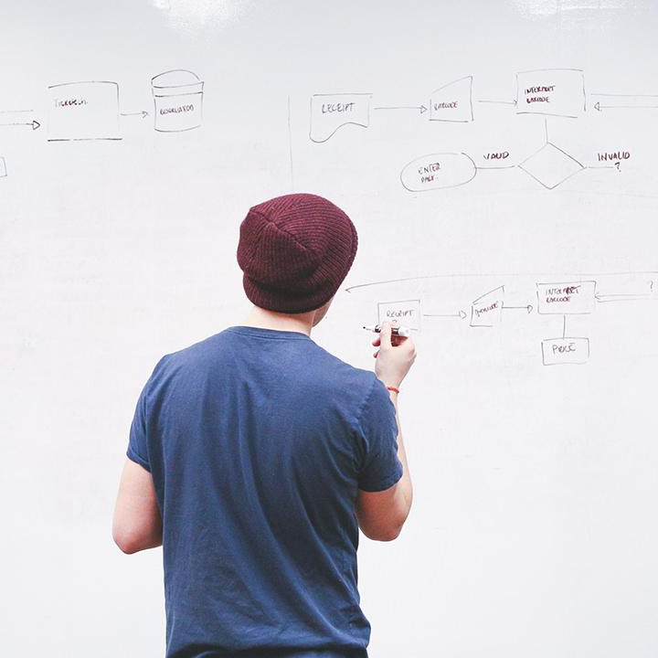
HELLO!
Here 1Crore Projects
I am here because I love to give presentations.
You can find me at @1CROREPROJECTS

Slide 2
Intelligent Health Diagnosis Technique Exploiting

Slide 3

AIM
The aim of the project the technique first automatically generates a human disease diagnosis ontology by exploiting two well-established ontologies for diseases and symptoms:

Slide 4
ABSTRACT
Growing interest in healthcare has promoted the use of symptom checkers, which are online health applications that provide diagnostic information on users’ health, their diagnostic accuracy remains low because the existing symptom checkers rely on manually constructed knowledge models through labor-intensive processes or perform diagnoses based on simple pairwise relationships between diseases and symptoms without considering personal health conditions. In this project, we propose an intelligent health diagnosis technique that exploits automatically generated ontology and Web-based personal health record services. The proposed technique first automatically generates a human disease diagnosis ontology by exploiting two well-established ontologies for diseases and symptoms:

Slide 5
INTRODUCTION
In today’s e-health era, the internet has become a common means of acquiring knowledge on personal health. they can easily confuse or misunderstand their health status by reviewing only high-ranked search results without filtering out irrelevant or unreliable health information.To acquire more reliable information, there has recently been a proliferation of online health applications called accuracy of 23 existing symptom checkers and found that they provided correct diagnoses in only 34% of test cases Diagnostic accuracy is a significant issue that affects user satisfaction and confidence in the validity of symptom checkers. Therefore, enhancing the value of these applications will require the development of more accurate and reliable diagnosis techniques.

Slide 6
EXISTING SYSTEM
In the test set, patients can be classified into groups of either high-risk or low-risk. These models are valuable in clinical situations and are widely studied.
Chen et.al proposed a healthcare system using smart clothing for sustainable health monitoring.
had thoroughly studied the heterogeneous systems and achieved the best results for cost minimization on tree and simple path cases for heterogeneous systems. Patients’ statistical information, test results and disease history are recorded in the EHR, enabling us to identify potential data-centric solutions to reduce the costs of medical case studies
proposed an optimal big data sharing algorithm to handle the complicate data set in tele health with cloud techniques. One of the applications is to identify high-risk patients which can be utilized to reduce medical cost since high-risk patients often require expensive healthcare.

Slide 7
DISADVANTAGE
In the existing system the data set is typically small, for patients and diseases with specific conditions, the characteristics are selected through experience. However, these pre-selected characteristics maybe not satisfy the changes in the disease and its influencing factors.
Lower Accuracy
More Time Consuming

Slide 8
PROPOSE SYSTEM
We combine the structured and unstructured data in healthcare field to assess the risk of disease. First, we used latent factor model to reconstruct the missing data from the medical records collected from a hospital in central China. For unstructured text data, we select the features automatically using CNN algorithm. Finally, we propose a novel CNN-based multimodal disease risk prediction (CNN) algorithm for structured and unstructured data.
The disease risk model is obtained by the combination of structured and unstructured features. Through the experiment, we draw a conclusion that the performance of CNN is better than other existing methods.

Slide 9
ADVANTAGES
Higher Accuracy.
We leverage not only the structured data but also the text data of patients based on the proposed CNN algorithm.
We find that by combining these two data, the accuracy rate can reach 94.80%, so as to better evaluate the risk of cerebral infarction disease.
To the best of our knowledge, none of the existing work focused on both data types in the area of medical big data analytics.

Slide 10
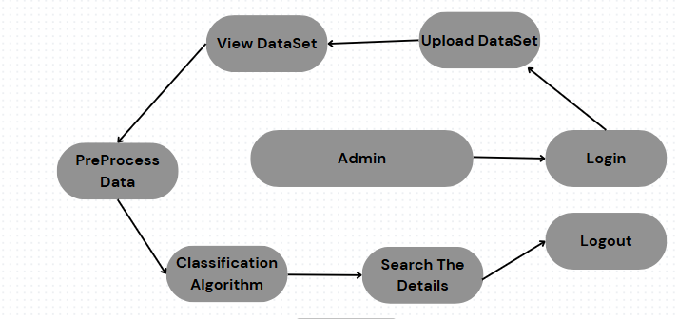
SYSTEM ARCHITECTURE
Cloud

Slide 11
MODULES
SEARCH MODULE
Admin:
Upload dataset
View dataset
Pre-processing
Search details
Analysis

Slide 12
HARDWARE REQUIREMENTS
System : Intel i3.
Hard Disk : 40 GB.
Floppy Drive : 1.44 Mb.
Monitor : 15 VGA Colour.
Mouse : Logitech.
Ram : 2GB

Slide 13
SOFTWARE REQUIREMENTS
Operating system : Windows 7/10.
Coding Language : JAVA
Data Base : MYSQL
IDE : NetBeans

Slide 14
FUTURE WORK
In future an intelligent system may be developed that can lead to selection of proper treatment methods for a patient diagnosed with heart disease. A lot of work has been done already in making models that can predict whether a patient is likely to develop heart disease or not. There are several treatment methods for a patient once diagnosed with a particular form of heart disease. Data mining can be of very good help in deciding the line of treatment to be followed by extracting knowledge from such suitable databases.

Slide 15
CONCLUSION
In this project, we have proposed an intelligent health diagnosis technique that provides reliable diagnostic results to users, thus helping them to take appropriate healthcare actions. Using three types of biomedical resources,. A definitive diagnosis must be rendered by medical experts. We only claim that our proposed technique can be used as a complementary healthcare tool that provides more reliable diagnostic guidance than currently existing symptom checkers and related approaches. Also, other limitations of our proposed technique are that we only considered diseases, symptoms, and personal health attributes that are recorded in PHR services, even though a diagnosis might be affected by a wide range of attributes including exercise, nutrition, and lifestyle

Slide 16
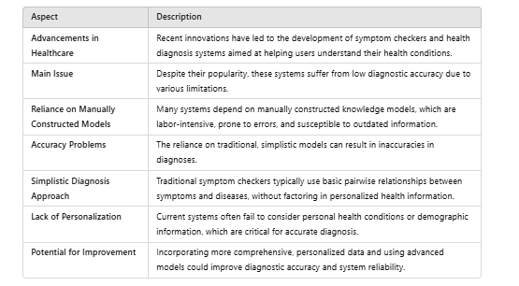
LITERATURE SURVEY

Slide 17
REFERENCE
[1] K. Khoo, P. Bolt, F. E. Babl, S. Jury, and R. D. Goldman, ‘‘Health information seeking by parents in the Internet age,’’ J. Paediatrics Child Health, vol. 44, nos. 7–8, pp. 419–423, Jun. 2008.
[2] W. Jacobs, A. O. Amuta, K. C. Jeon, and C. Alvares, ‘‘Health information seeking in the digital age: An analysis of health information seeking behavior among US adults,’’ Cogent Social Sci., vol. 3, no. 1, Mar. 2017, Art. no. 1302785.
[3] R. W. White and E. Horvitz, ‘‘Cyberchondria: Studies of the escalation of medical concerns in Web search,’’ ACM Trans. Inf. Syst., vol. 27, no. 4, pp. 1–37, Nov. 2009.

Slide 18
THANKS!
Any questions?
You can find me at
Reach us – 1croreprojects@gmail.com
Contact / Whatsapp: 7708 150 152 / 9751 800 789 / 790 432 0834

